Slide 1
Predicting Inflation in Nigeria: Leveraging Machine Learning
Understanding the Factors Influencing Inflation and Exploring Predictive Models
Presenters: Group 1
Date: 30TH August, 2024

Slide 2






Group Members
Abdullahi Sada
Cletus Alexander
Sylvanus Jedidiah
Aderibigbe Olamide
Yusuf Abdulhadi
Aisha Raji

Slide 3
Introduction
Problem Statement: Inflation is a persistent challenge in Nigeria, eroding purchasing power and threatening economic stability.
Objective: Utilize machine learning to predict inflation based on various economic indicators.

Slide 4
Dataset Overview
Variables Included:
Inflation Rate
US Dollar Selling rate
US Dollar Buying rate
CPI_Food
CPI_Energy
CPI_Health
CPI_Transport
CPI_Communication
CPI_Education
Data Source:
Central Bank of Nigeria
National Bureau of Statistics

Slide 5
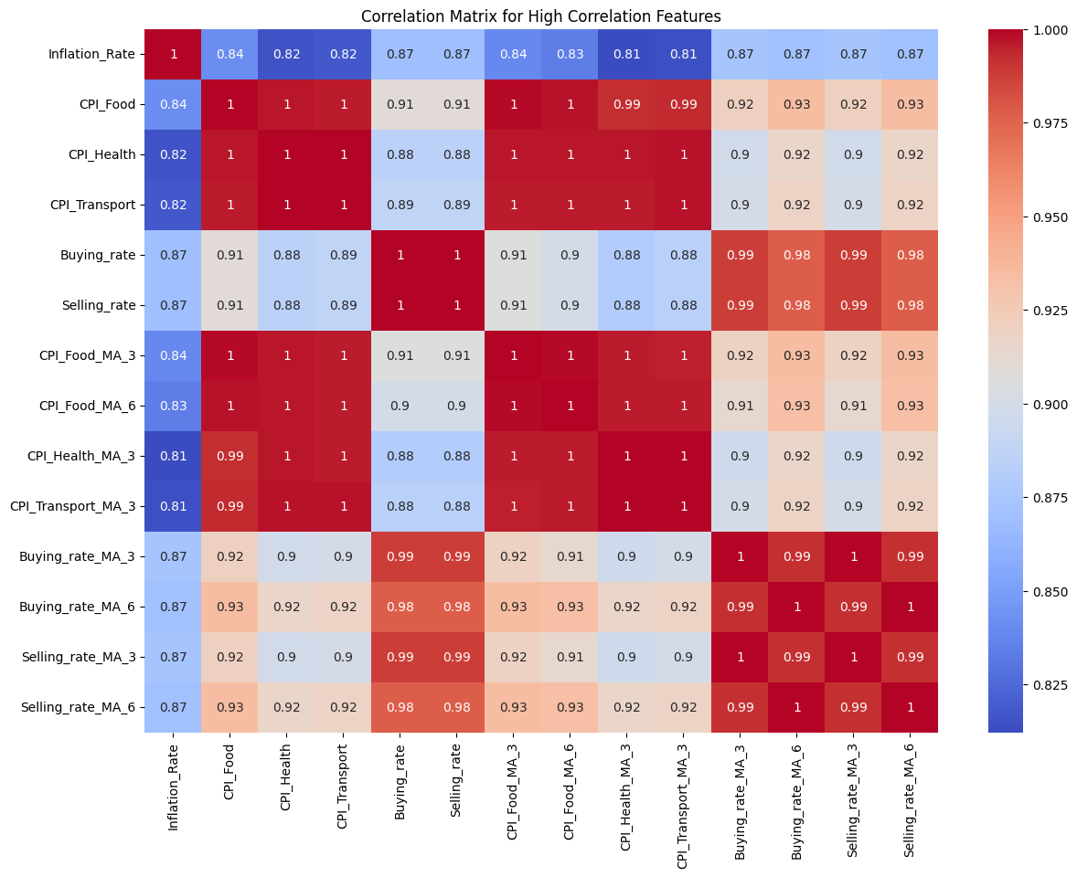
Correlation Analysis

Slide 6
Machine Learning Algorithms
Objective:
Explore different machine learning models for predicting inflation.
Algorithms Discussed:
XGBoost Regressor
Bayesian Regression
Random Forest Regressor
Lasso Regression

Slide 7
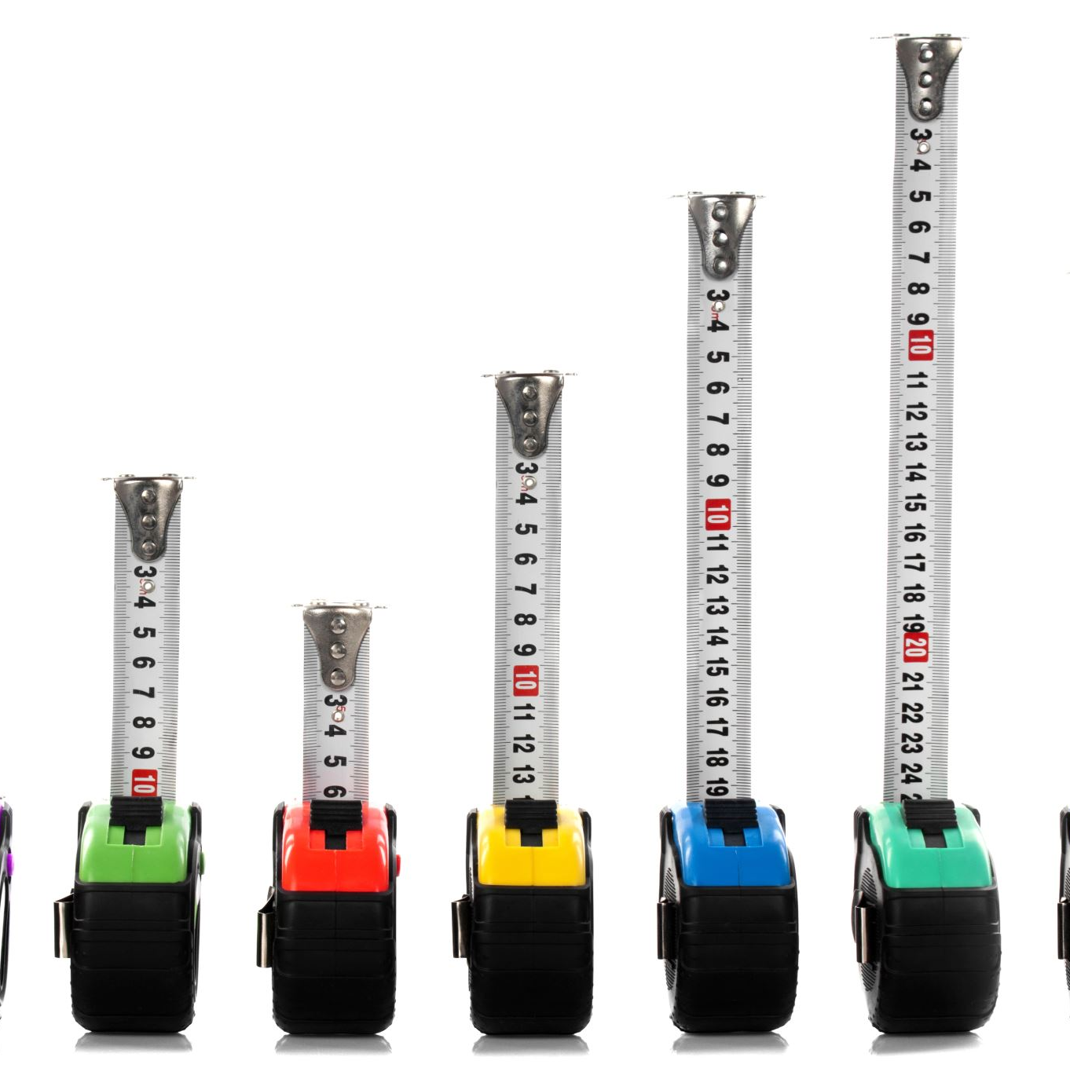
Performance Metrics
Metrics Used:
Mean Squared Error (MSE)
Mean Absolute Error (MAE)
R-squared (R²)

Slide 8

Model Development Phases

Slide 9
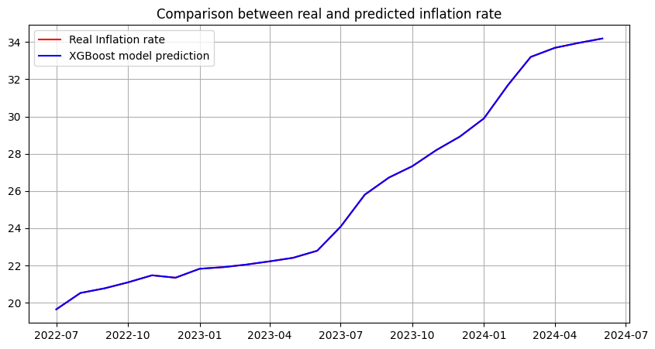
Initial Model: XGBoost Regression
Observation:
Despite high accuracy, this model struggled to extrapolate
Model | MAE | MSE | R² Score
XGBoost regression | 1.228713e-08 | 2.537890e-16 | 1.0

Slide 10
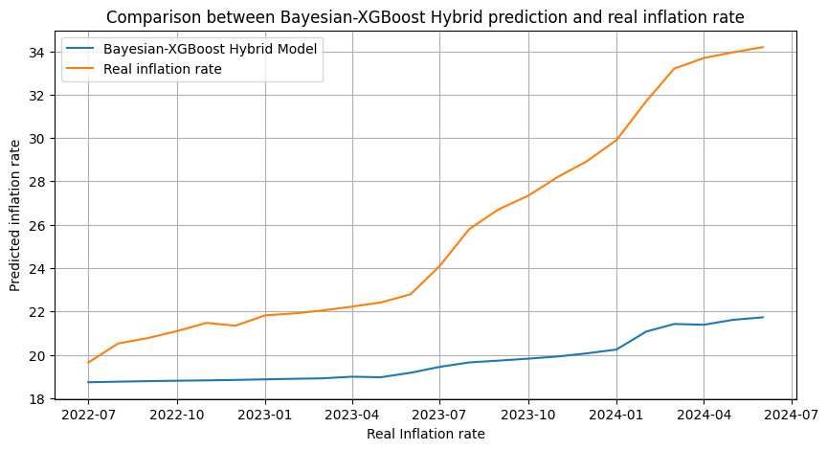
Alternative approach: Bayesian-XGBoost Hybrid Model
Objective: To improve predictive ability by capturing trend and noise in data
Observation: Model consistently underestimates the inflation rate
Model | MAE | MSE | R² Score
Bayesian-XGBoost Hybrid | 5.963207 | 50.220884 | -1.163898

Slide 11
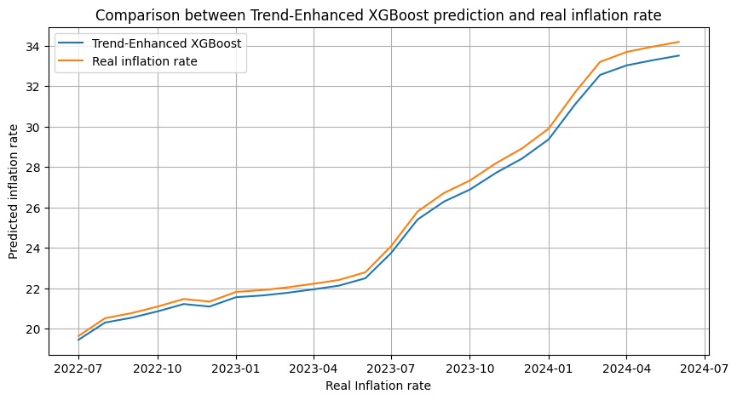
Final model: Trend-Enhanced XGBoost Model
Objective: To improve inflation forecast of XGBoost model by integrating trend analysis using Bayesian regression
Observation: This model overcame the challenge of the previous model and can forecast inflation is both stable and rising trend
Model | MAE | MSE | R² Score
Trend-Enhanced XGBoost Model | 0.391169 | 0.179469 | 0.992267

Slide 12
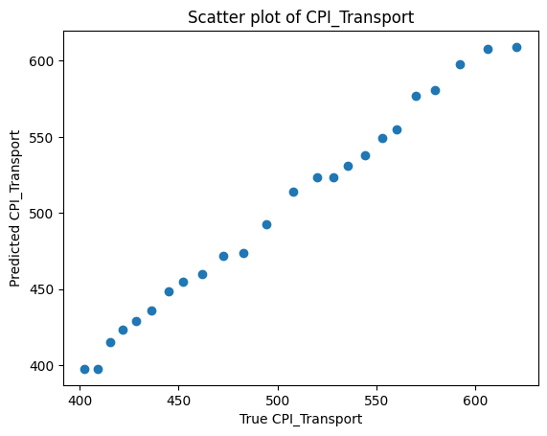
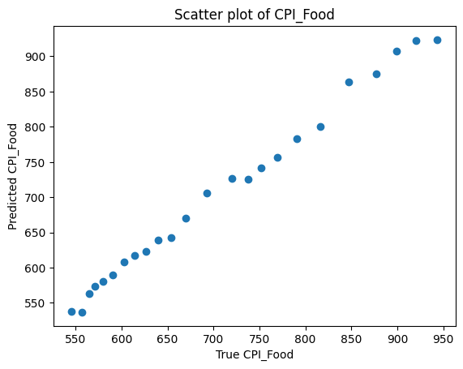
Enhancing Feature Predictions through Dollar Exchange Rate
Objective: To improve feature prediction accuracy by leveraging strong correlation between dollar exchange rate and key economic indicators.
Approach: Instead of manipulating each feature with random weights, we focused on the exchange rate as a central driver ensuring inflation predictions are both robust and economically coherent.

Slide 13
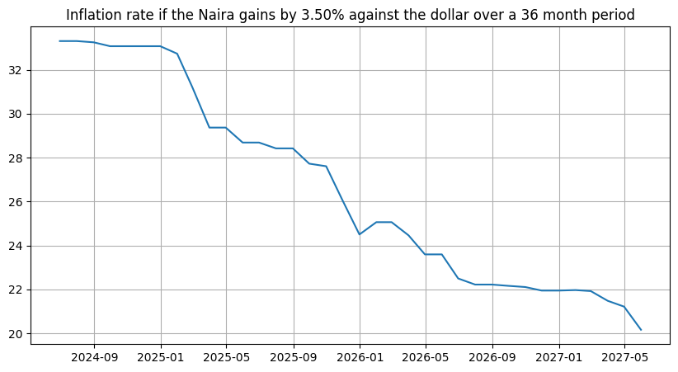
Forecast: Inflation Rate as Naira Gains

Slide 14
Conclusion
Summary:
Accurate inflation forecasting is vital for informed economic planning, policy formulation, and decision-making.
Leveraging machine learning allows for more precise predictions by analyzing complex relationships among economic indicators.
Next Steps:
Enhance model accuracy by integrating a more diverse data source and refining feature selection.
Collaborate with policymakers to translate predictions into strategic actions that stabilize and guide economic growth.

Slide 15
THANK YOU!

